Slide 1
vintage game design
day 1

Slide 2
making games for the atari 2600
day 1

Slide 3
right place?

Slide 4
the deal
Notes:
I am in the midst of making a course based on vintage game design. I want to include everything from the Fairchild Channel F up to around the SNES. Just a basic intro to how they work, making a game or a demo, and letting folks have a ton of historical context,

Slide 5


Slide 6
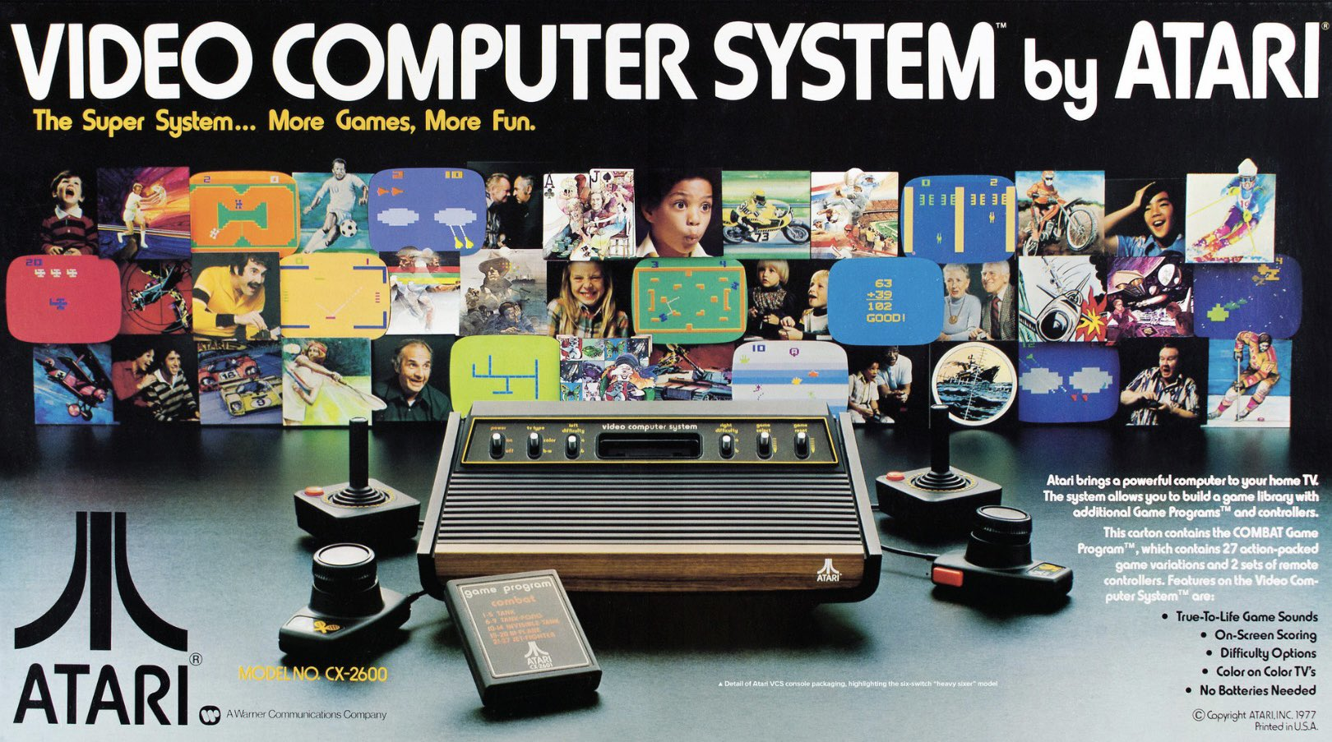
Notes:
So, Atari was not the first game company. Hell, it wasn’t even the first generation of console. It didn’t create video games, we can say those began even as far back as the 1800s with the mechanical turk.
But, this is where we can say video games established a few things.

Slide 7
not origin but where we began
Notes:
So, Atari was not the first game company. Hell, it wasn’t even the first generation of console. It didn’t create video games, we can say those began even as far back as the 1800s with the mechanical turk.
But, this is where we can say video games established a few things.

Slide 8
what matters? who cares?
Notes:
If Atari asn’t the origin but where we started, what parts of that matter? Who cares?

Slide 9
credits for designers
Notes:
Well, the first is probably the most important. We now know who designed games.
How many designers do you know?

Slide 10
3rd party games
Notes:
Because of the aura surrounding credits for designers, we got 3rd party games.

Slide 11
pipelines
Notes:
Atari used to lock employees in their offices and demand they could not leave til games were done. This style of work is now called crunch and seen as bad. It started here.

Slide 12
what a video game is
Notes:
Nintendo sort of owns this now as Microsoft is concerned with sales of its other divisions and Sony is as well. Sega partially cared but now all of the former care about gamers rather than games. We owe this path to Atari who ultimately lost control of the concept though it all sits at the center of what Nintendo now owns.

Slide 13
legendary games
Notes:
We also found innumerable games that formed the basis of a TON of genre and types.

Slide 14
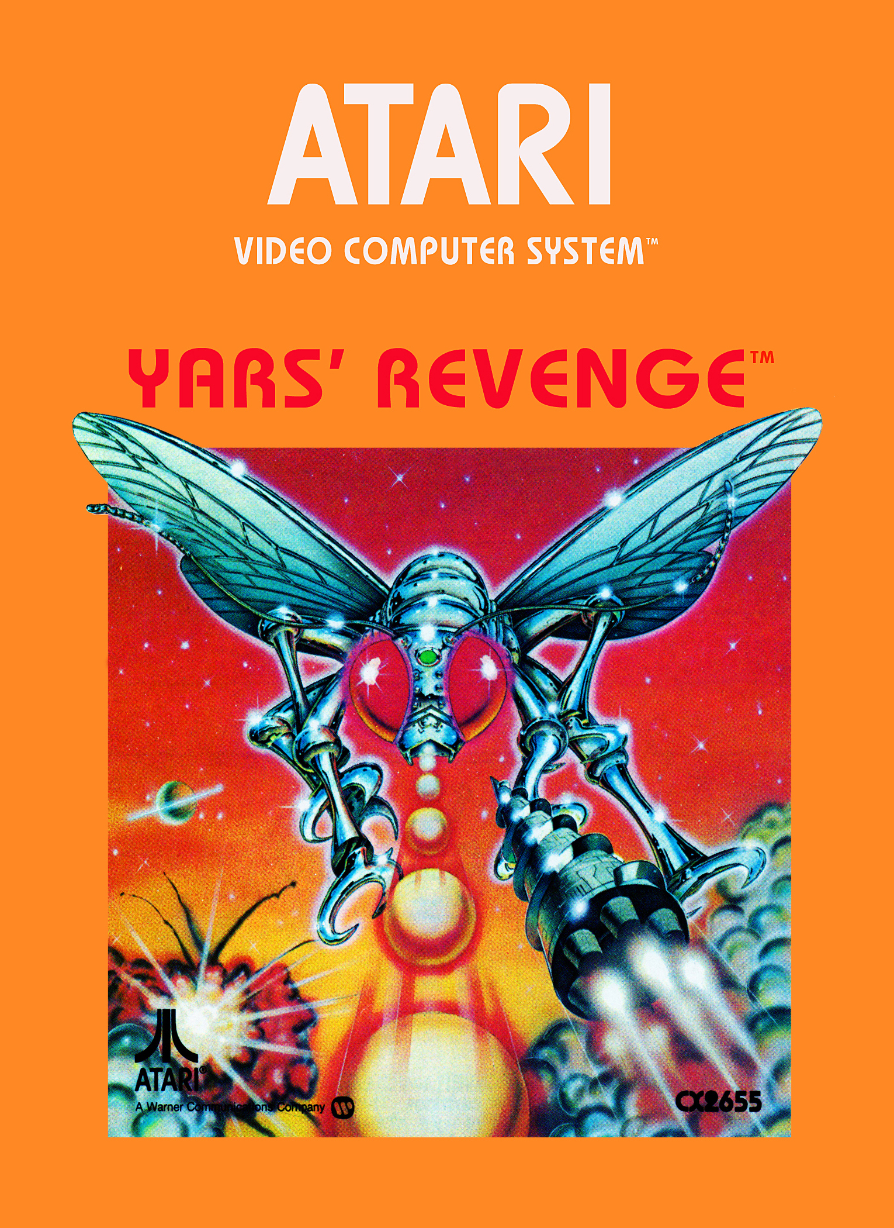
Howard Scott Warshaw still considered a top 100 game

Slide 15
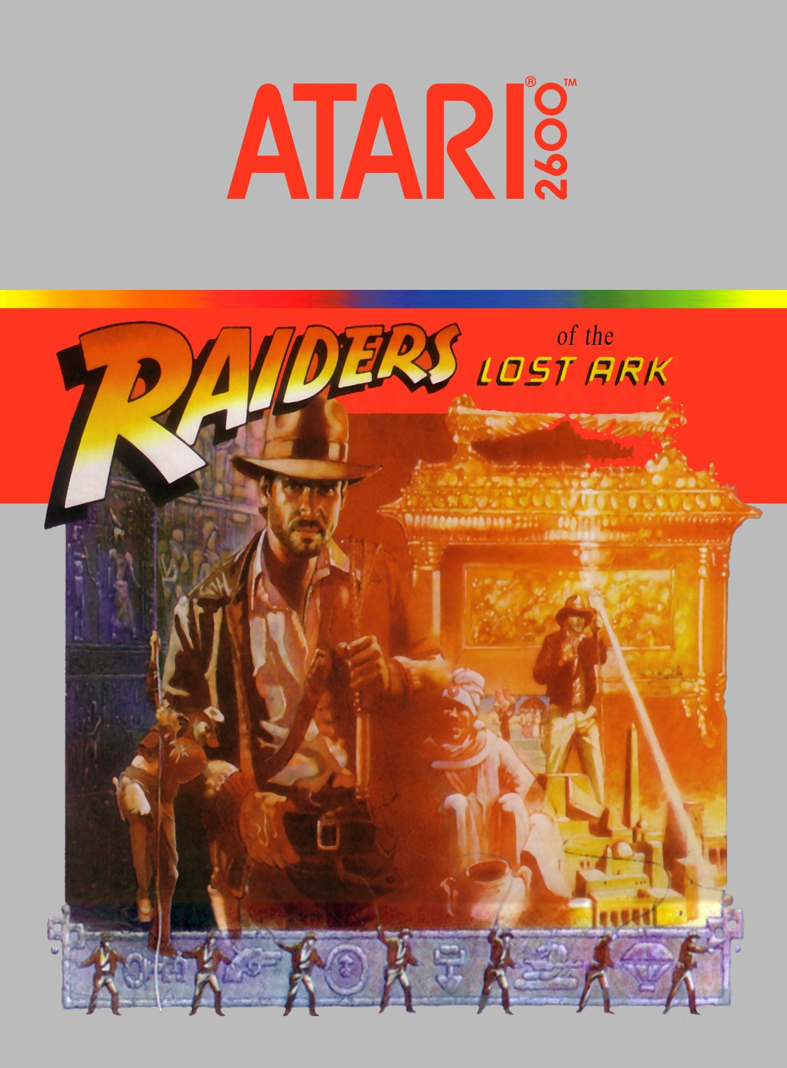
Howard Scott Warshaw surprisingly complex

Slide 16
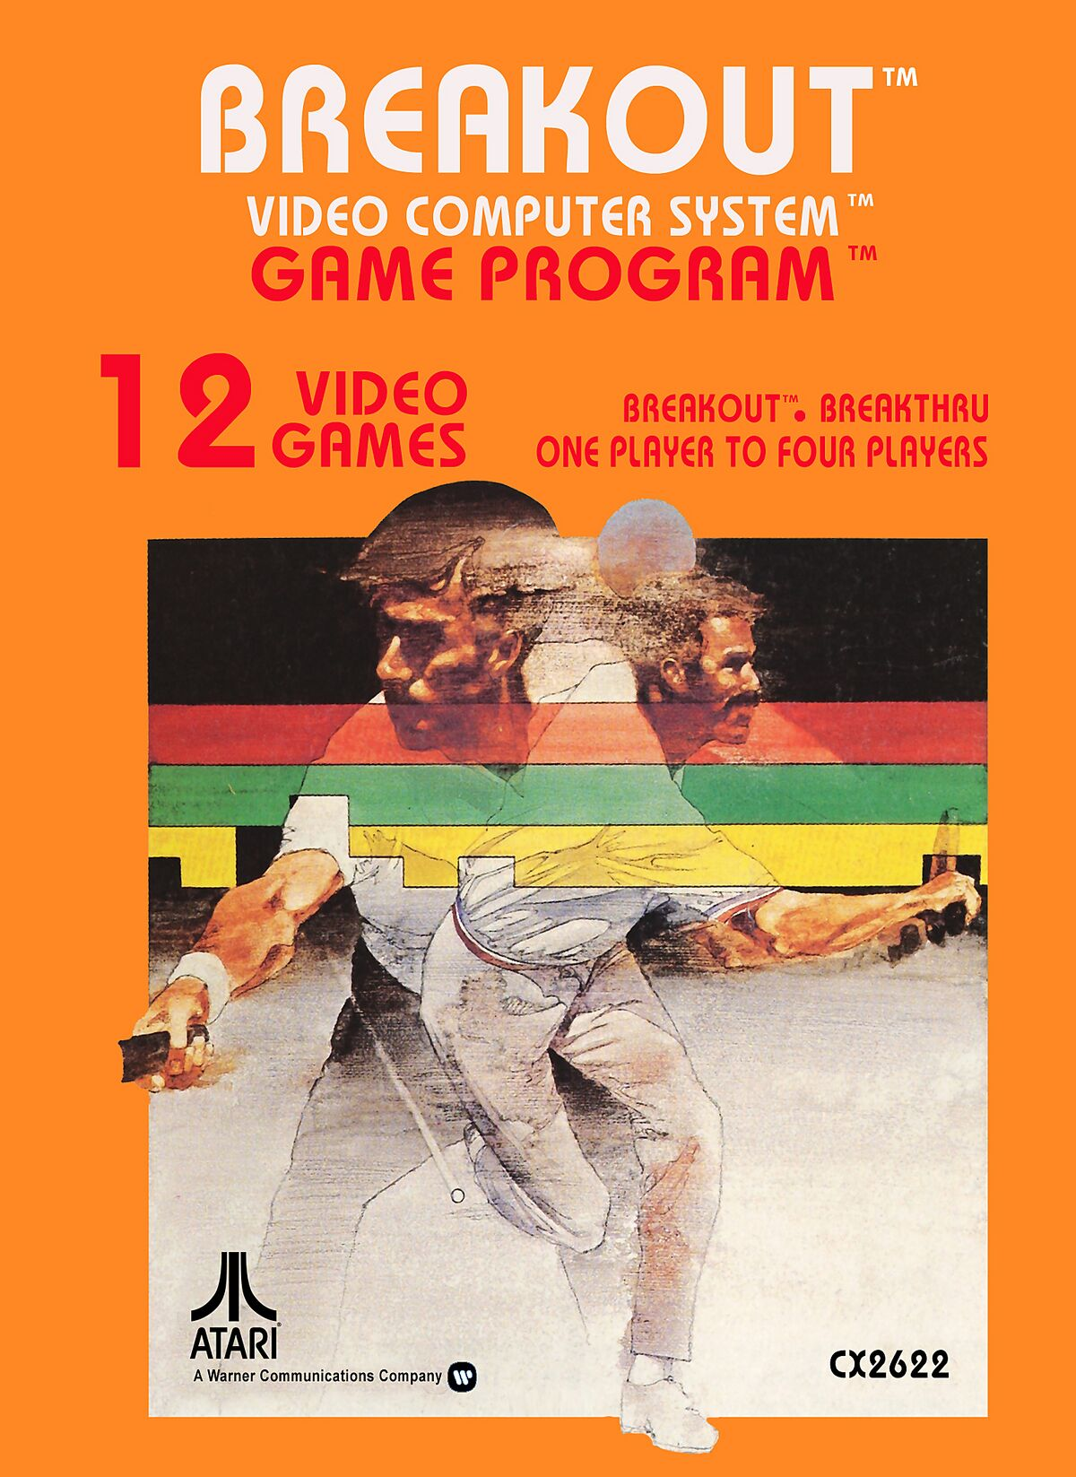
why is this here?
Notes:
Woz wrote original port, Brad Stewart wrote 2600 version. I wanted to note it here.

Slide 17
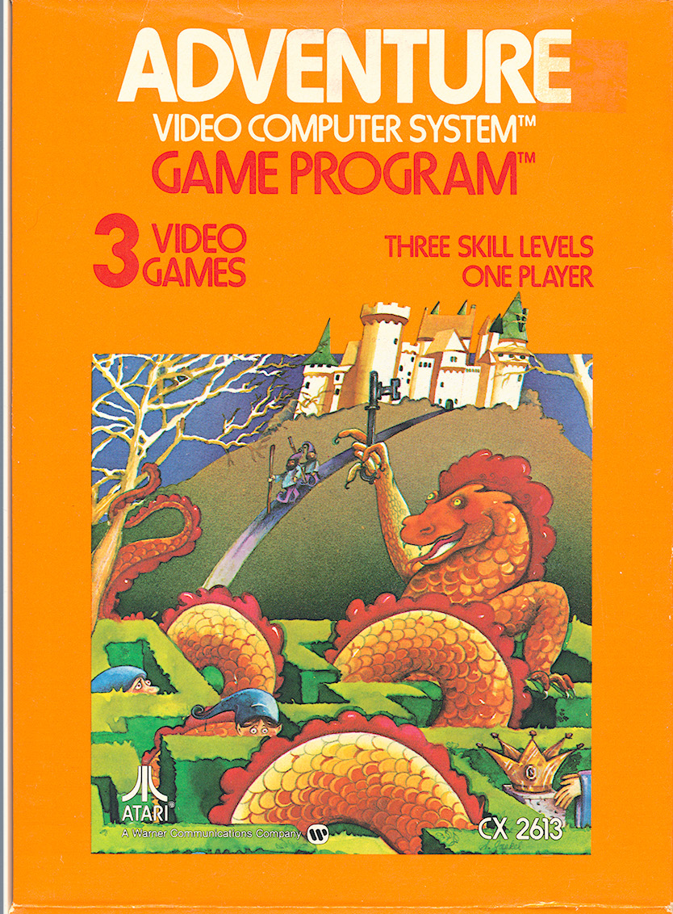
You guys are no more important to Atari than the guy on the assembly line who assembles the cartridges.
Notes:
Warren Robinett

Slide 18
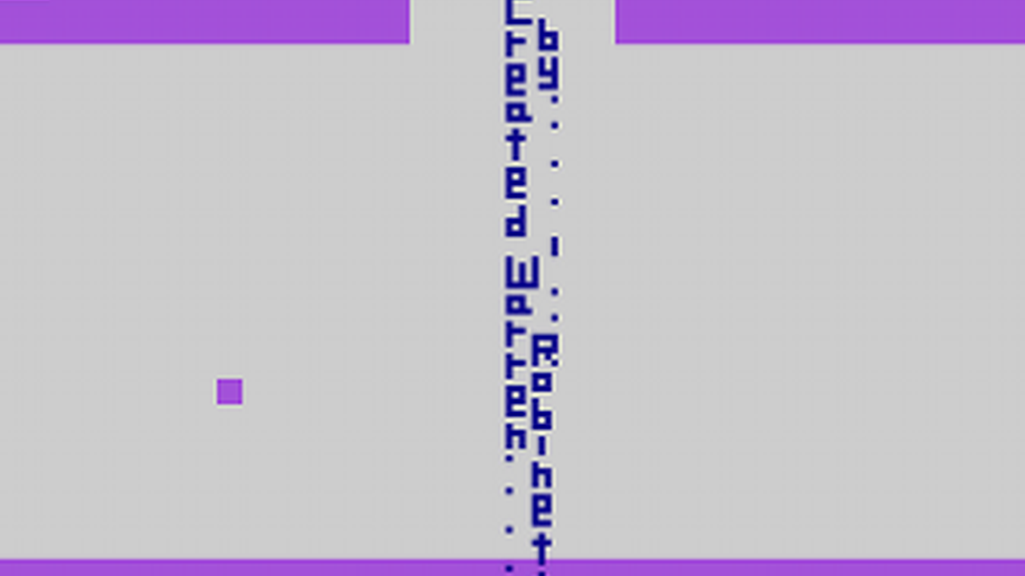

Slide 19
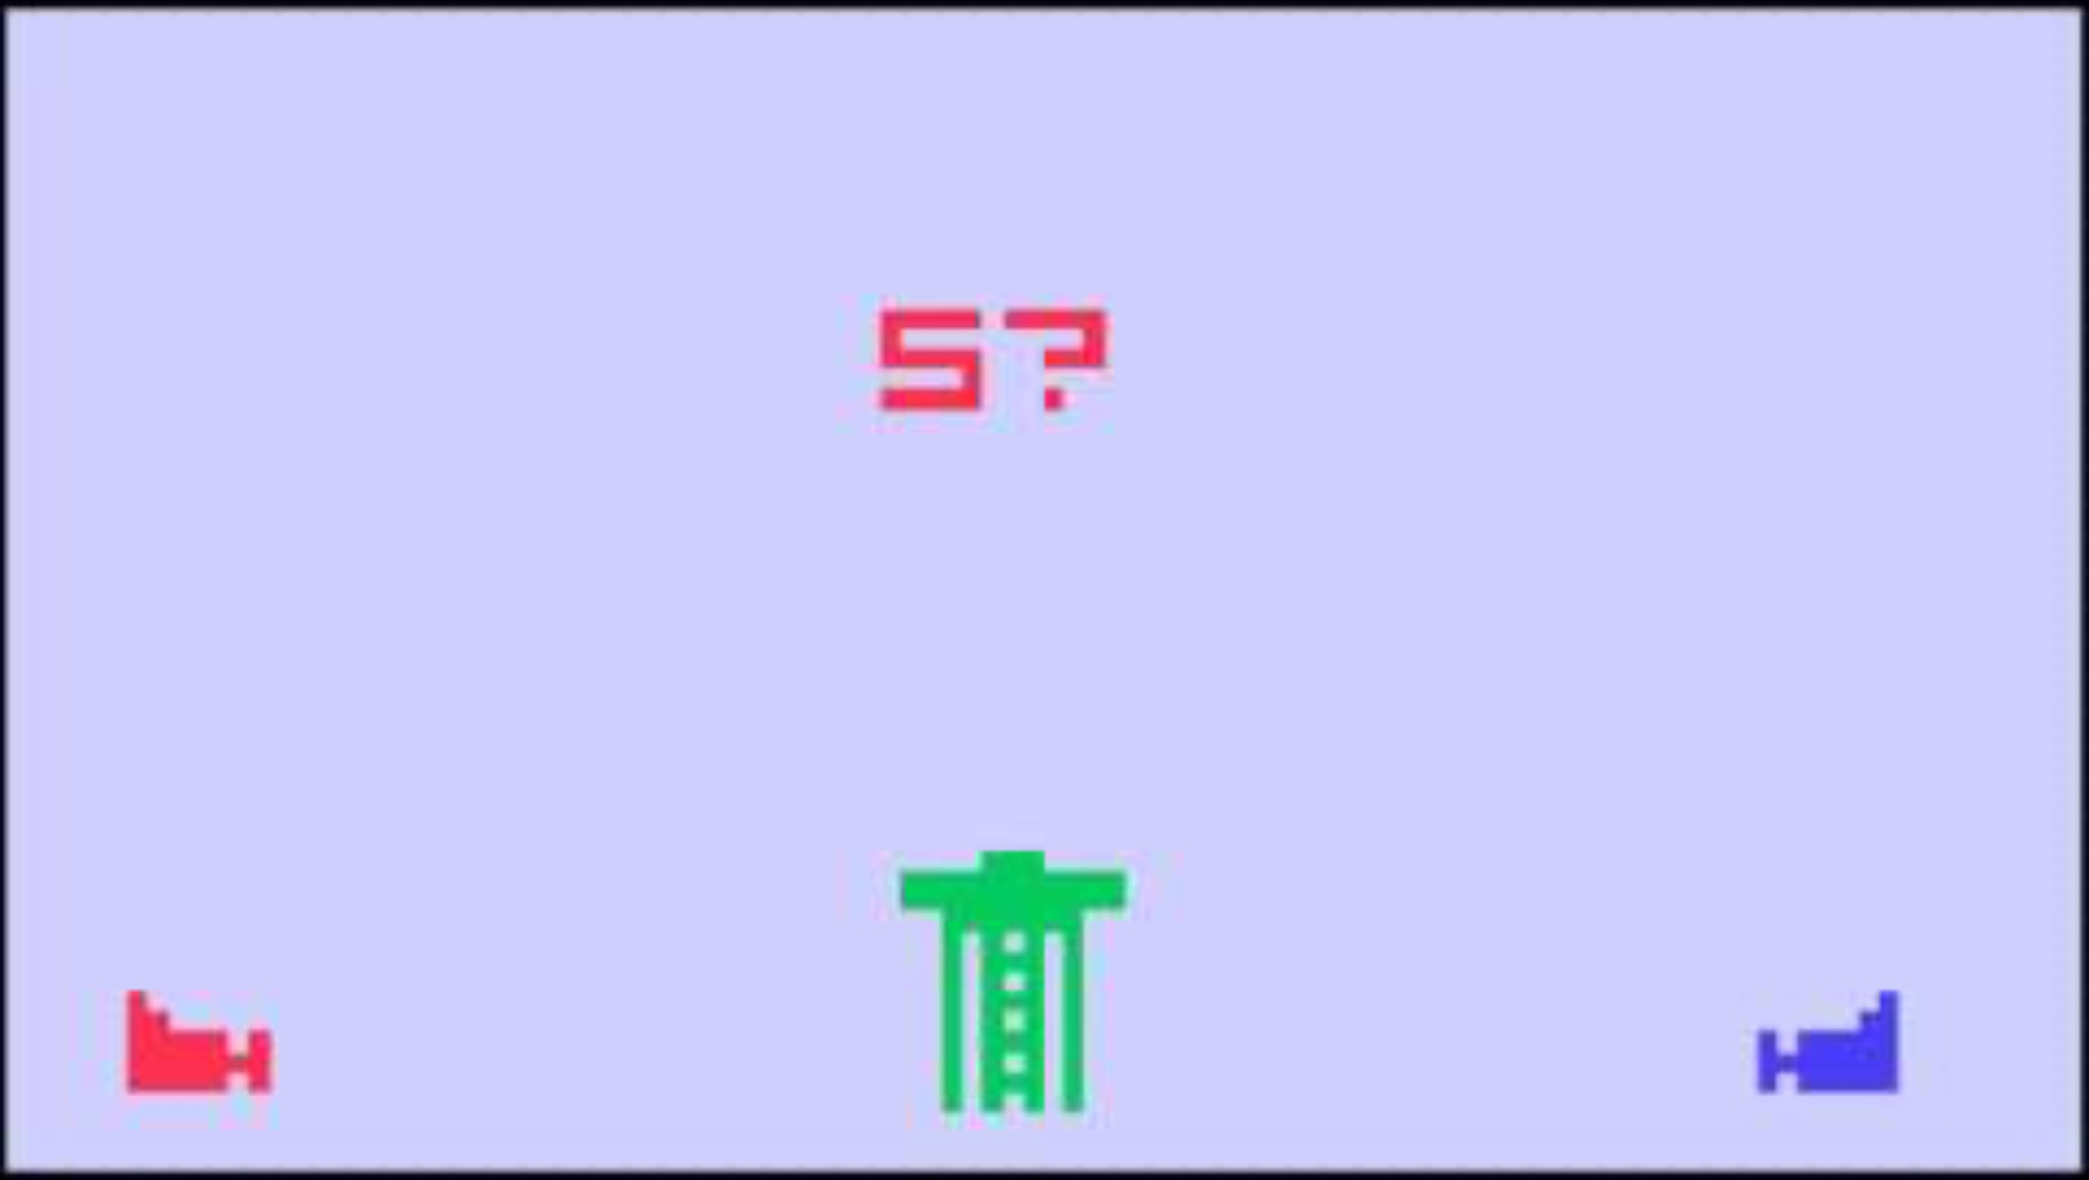

Slide 20

Carol Shaw best Selling scrolling still important
Notes:
River Raid: https://www.inverse.com/gaming/river-raid-40th-anniversary-carol-shaw
One of the best selling games for the 2600, ported everywhere. One of the first games designed by a woman. The source code for this game is at the Strong. She hand wrote it.

Slide 21
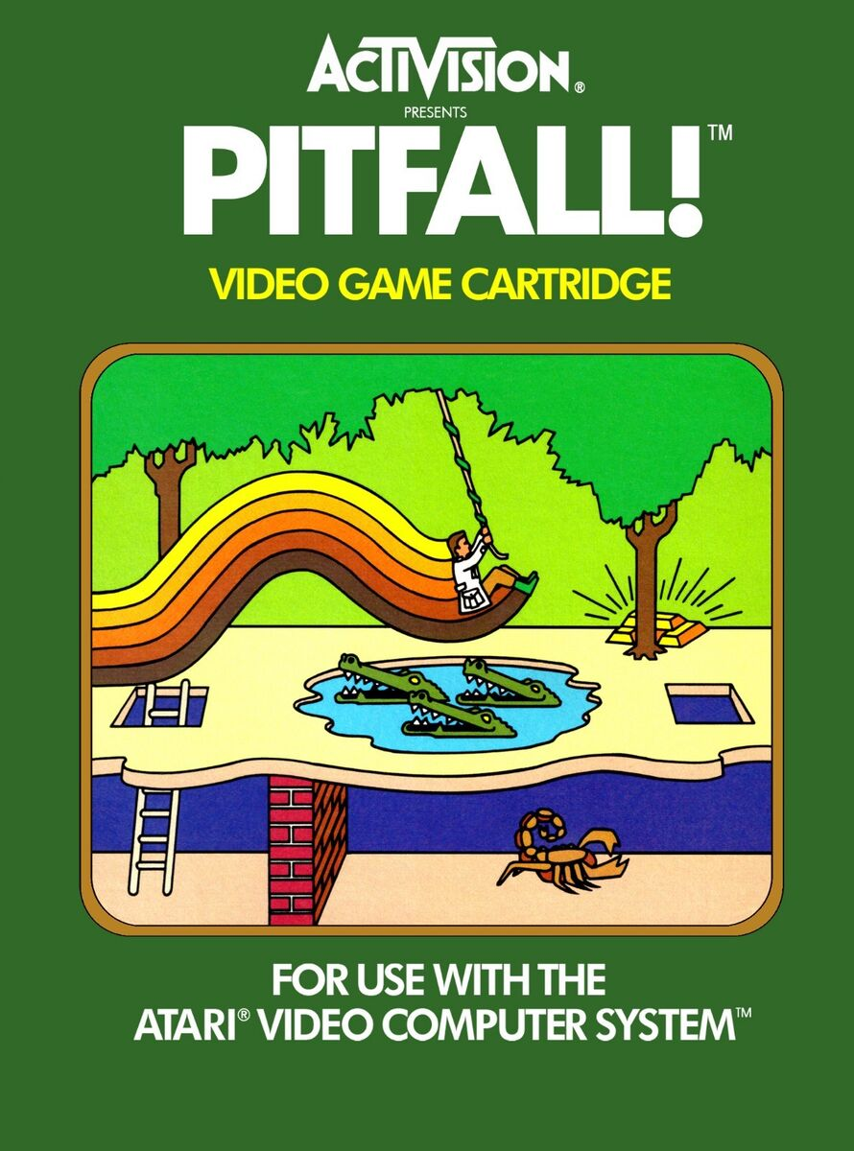
David Crane 255 Screens platformer procgen
Notes:
Crane commented that "The entire [game design] process took about 10 minutes. About 1000 hours of programming later the game was complete."^{[11]} Much of Crane's time was spent optimizing and compressing the code so that it would fit into a four-kilobyte ROM cartridge.^{[16]} Unlike Haunted House (1982) or Raiders of the Lost Ark (1982), where the environments were hard-coded into the game, Pitfall! was generated constantly by code.^{[13]} The game generates each screen based on a counter that could run either backwards or forwards depending which direction the player moved from screen to screen.^{[17]} The 8 bits in the counter were used to determine certain details such as the background, trees, ground and object patterns, allowing 255 screens to occupy fewer than 50 bytes of ROM.^{[18]} Activision had created design centers for their games, which were small, close-knit teams of four to five people.^{[19]} These teams encouraged peer reviews and shared prototypes of games. In Pitfall!, Crane's team changed the initial number of lives in the game from one to three during the final week of development.^{[20]} Crane said that "my buddies practically tied me to my chair until I put in extra lives and I'm glad they did".^{[20]}

Slide 22
how class work?

Slide 23
assembly 6502

Slide 24
a caveat

Slide 25
a caveat

Slide 26
3 tasks

Slide 27
read and write

Slide 28
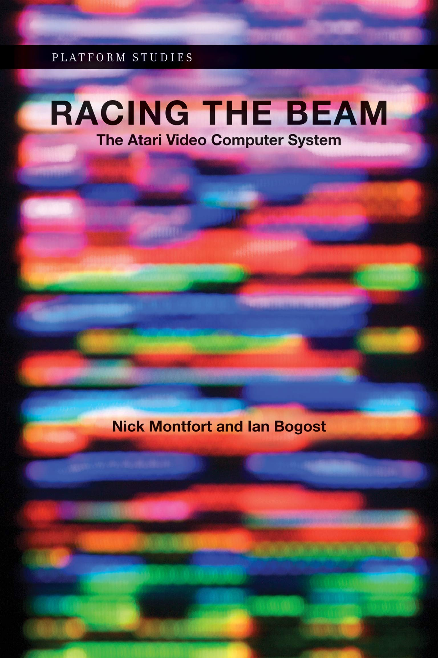
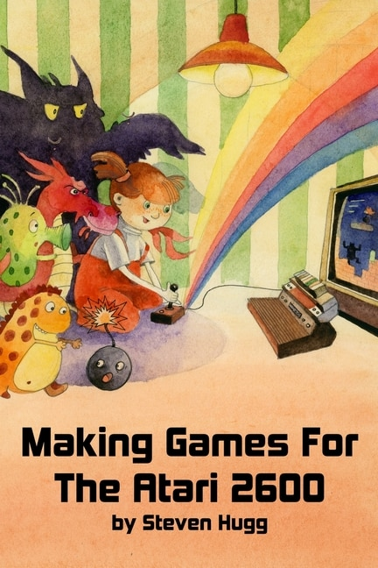

Slide 29
source code problems

Slide 30
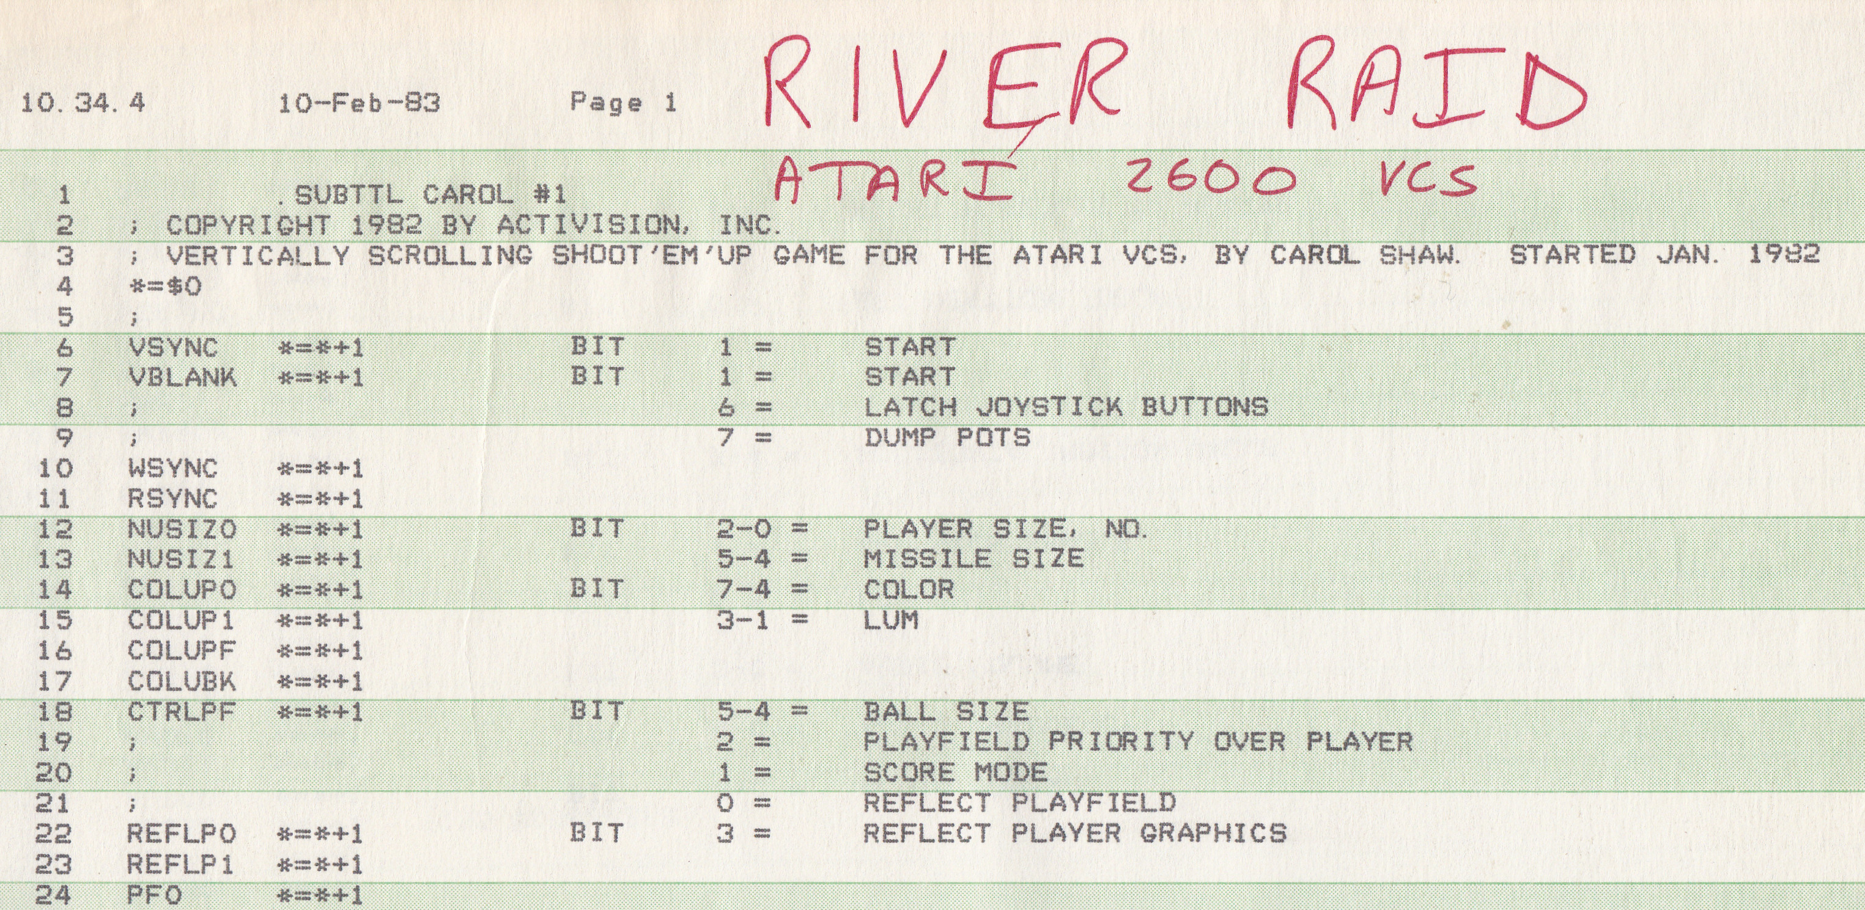

Slide 31
ET Challenge

Slide 32
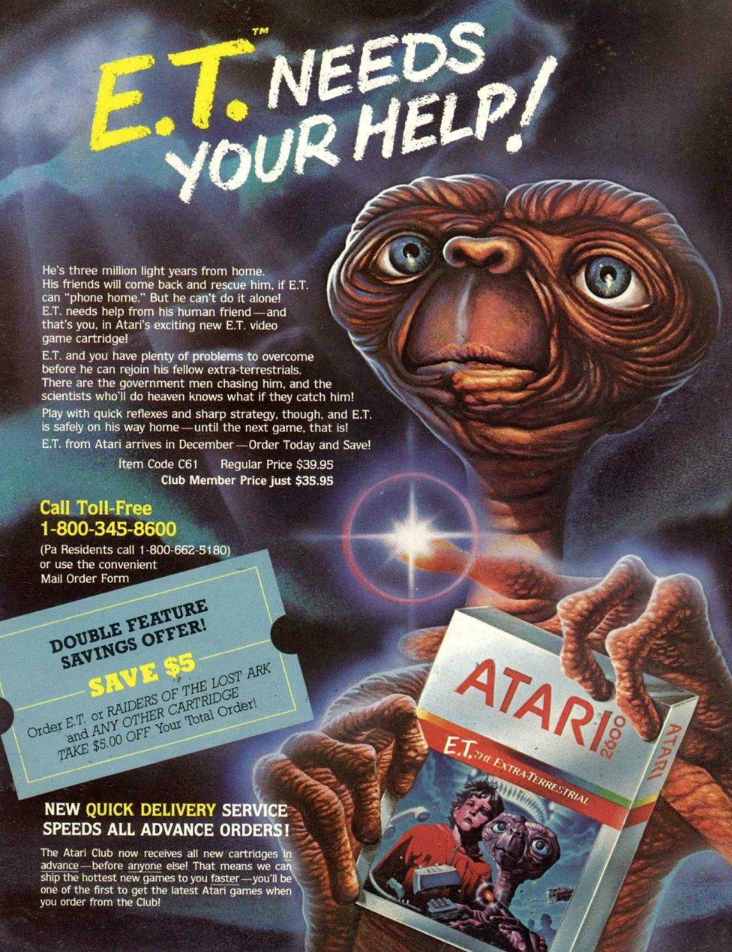
5 weeks alone? team? full game
Notes:
Activision had created design centers for their games, which were small, close-knit teams of four to five people.^{[19]} These teams encouraged peer reviews and shared prototypes of games. In Pitfall!, Crane's team changed the initial number of lives in the game from one to three during the final week of development.^{[20]} Crane said that "my buddies practically tied me to my chair until I put in extra lives and I'm glad they did".^{[20]}

Slide 33
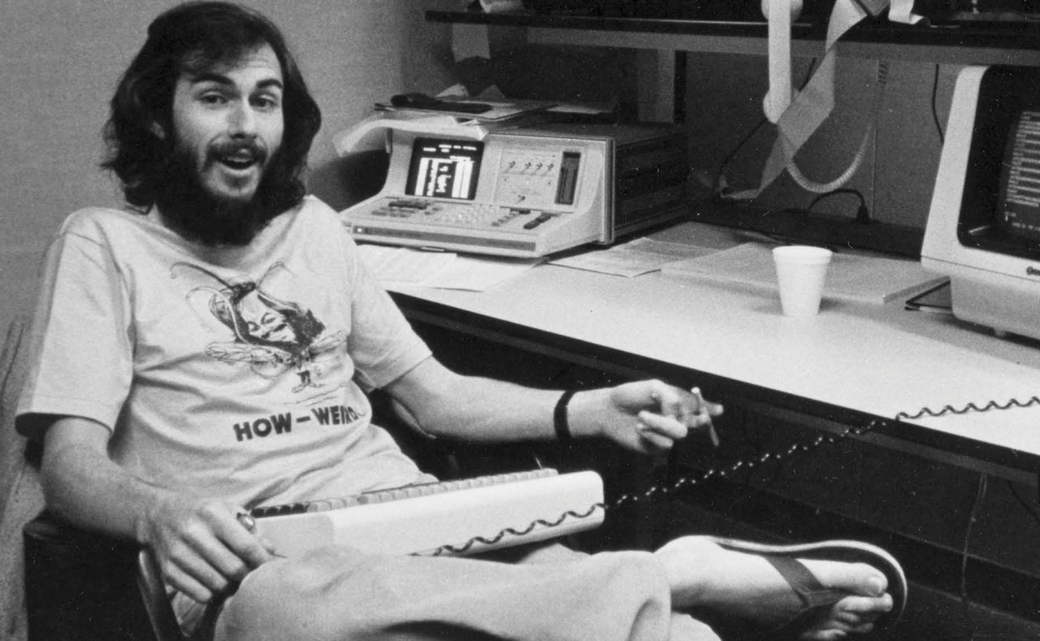

Slide 34
the 2600 was a real mess.

Slide 35
it's a good thing that we don't try to program machines like that anymore because it was just absurd.

Slide 36
but it was kind of fun in a sick way if you like that kind of challenge.

Slide 37
dark souls of designing games

Slide 38


Slide 39
qcc?

